Slide 1
Poisson Beta Regression for Count Data
Alan Herschtal
29th Nov. 2022

Slide 2
Modelling Count Data
Count data are often over-dispersed (variance > mean)
Poisson regression thus not appropriate
Negative Binomial (NB) regression used to handle over-dispersion
NB also often not flexible enough – e.g. can’t handle excess zeroes
‘Sequence count data are poorly fit by the negative binomial distribution’ (Hawinkel et al, 2020)
‘SimSeq: a nonparametric approach to simulation of RNA-sequence datasets’ (Benidt & Nettleton, 2015)

Slide 3
Motivating Example
Comparison of count of unnecessary biopsies between standard follow-up and melanoma surveillance photography (MSP) for melanoma
Count almost certainly over-dispersed → not Poisson
Possibly neither ZIP nor NB

Slide 4
WANTED
REWARD
Distribution with Support on {0, 1, 2, 3, …}
Flexible
3 parameter model (?)
ZIP and NB as special cases
Regression method available

Slide 5
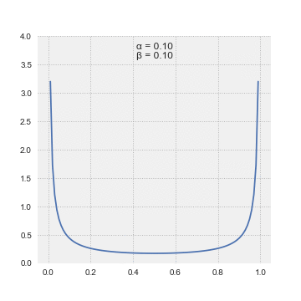
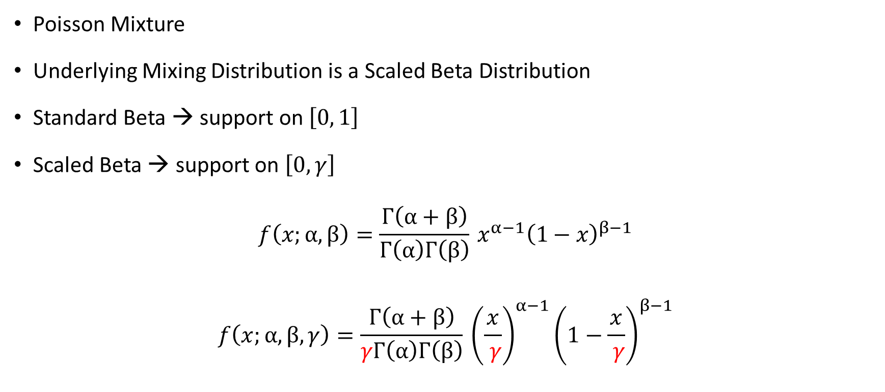
Poisson (Scaled) Beta
Poisson Mixture
Underlying Mixing Distribution is a Scaled Beta Distribution
Standard Beta → support on $\left[0, 1\right]$
Scaled Beta → support on $\left[0, γ\right]$
$$f\left(x;α,β\right)=\frac{Γ\left(α+β\right)}{Γ\left(α\right)Γ\left(β\right)} x^{α−1}{\left(1−x\right)}^{β−1}$$
$$f\left(x;α,β,γ\right)=\frac{Γ\left(α+β\right)}{γΓ\left(α\right)Γ\left(β\right)} {\left(\frac{x}{ γ}\right)}^{α−1}{\left(1−\frac{x}{ γ}\right)}^{β−1}$$

Slide 6
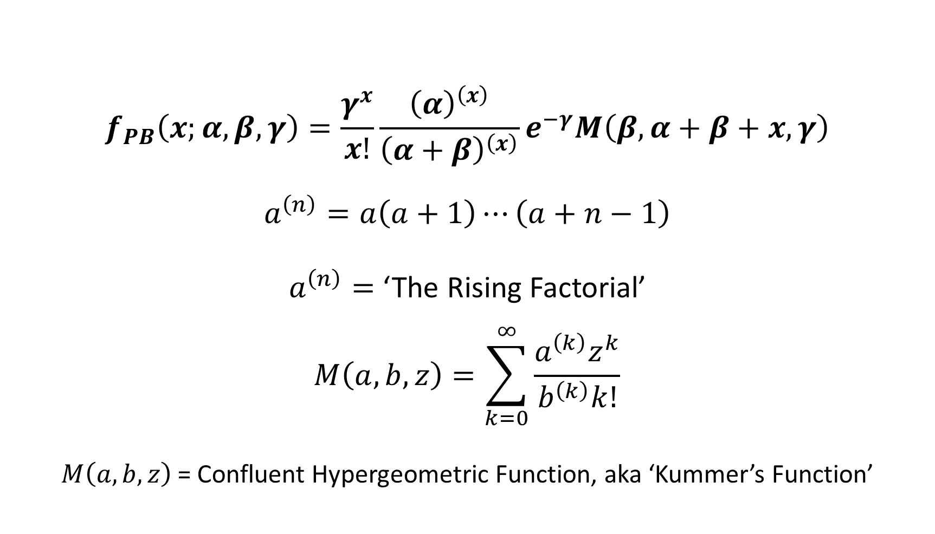
The Poisson Beta PDF
$$f_{PB}\left(x;α,β,γ\right)=\frac{γ^{x}}{x!}\frac{{\left(α\right)}^{\left(x\right)}}{{\left(α+β\right)}^{\left(x\right)}}e^{−γ}M\left(β,α+β+x, γ\right)$$
$$a^{\left(n\right)}=a\left(a+1\right)⋯\left(a+n−1\right)$$
$a^{\left(n\right)}=$ ‘The Rising Factorial’
$$M\left(a,b,z\right)=\sum_{k=0}^{∞}{\frac{a^{\left(k\right)}z^{k}}{b^{\left(k\right)}k!}}$$
$M\left(a,b,z\right)$ = Confluent Hypergeometric Function, aka ‘Kummer’s Function’

Slide 7
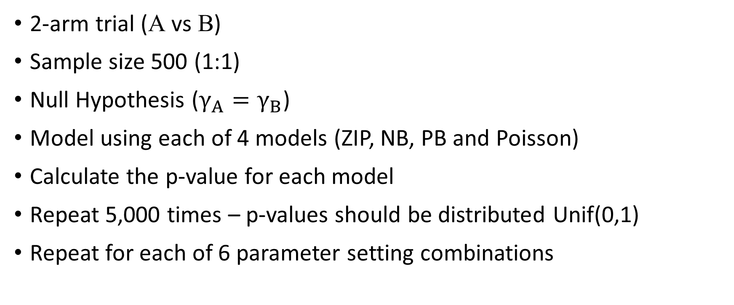
Testing scenarios – synthetic data
2-arm trial (A vs B)
Sample size 500 (1:1)
Null Hypothesis ($γ_{A}=γ_{B}$)
Model using each of 4 models (ZIP, NB, PB and Poisson)
Calculate the p-value for each model
Repeat 5,000 times – p-values should be distributed Unif(0,1)
Repeat for each of 6 parameter setting combinations

Slide 8
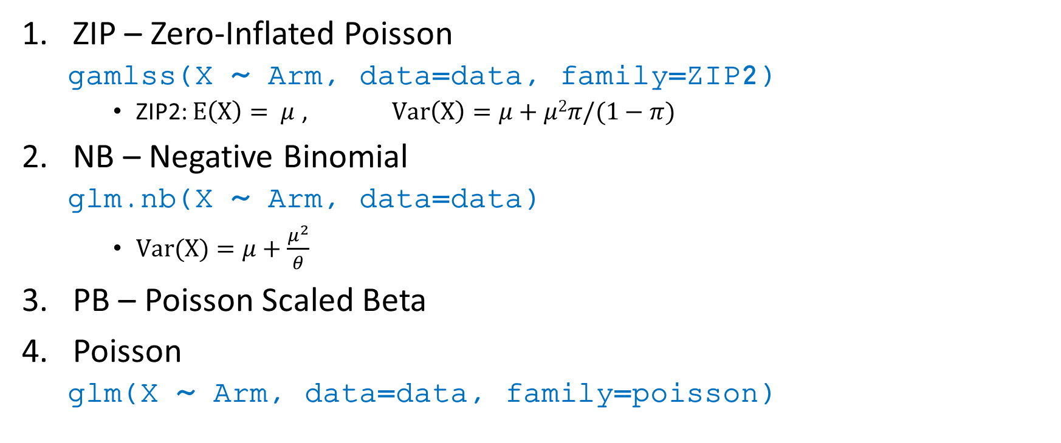
Simulation Set up – Four Models
ZIP – Zero-Inflated Poisson
gamlss(X ~ Arm, data=data, family=ZIP2)
ZIP2: $E\left(X\right)= μ$ , $Var\left(X\right)=μ+μ2π/(1−π)$
NB – Negative Binomial
glm.nb(X ~ Arm, data=data)
$Var(X)=μ+\frac{μ^{2}}{θ}$
PB – Poisson Scaled Beta
Poisson
glm(X ~ Arm, data=data, family=poisson)

Slide 9
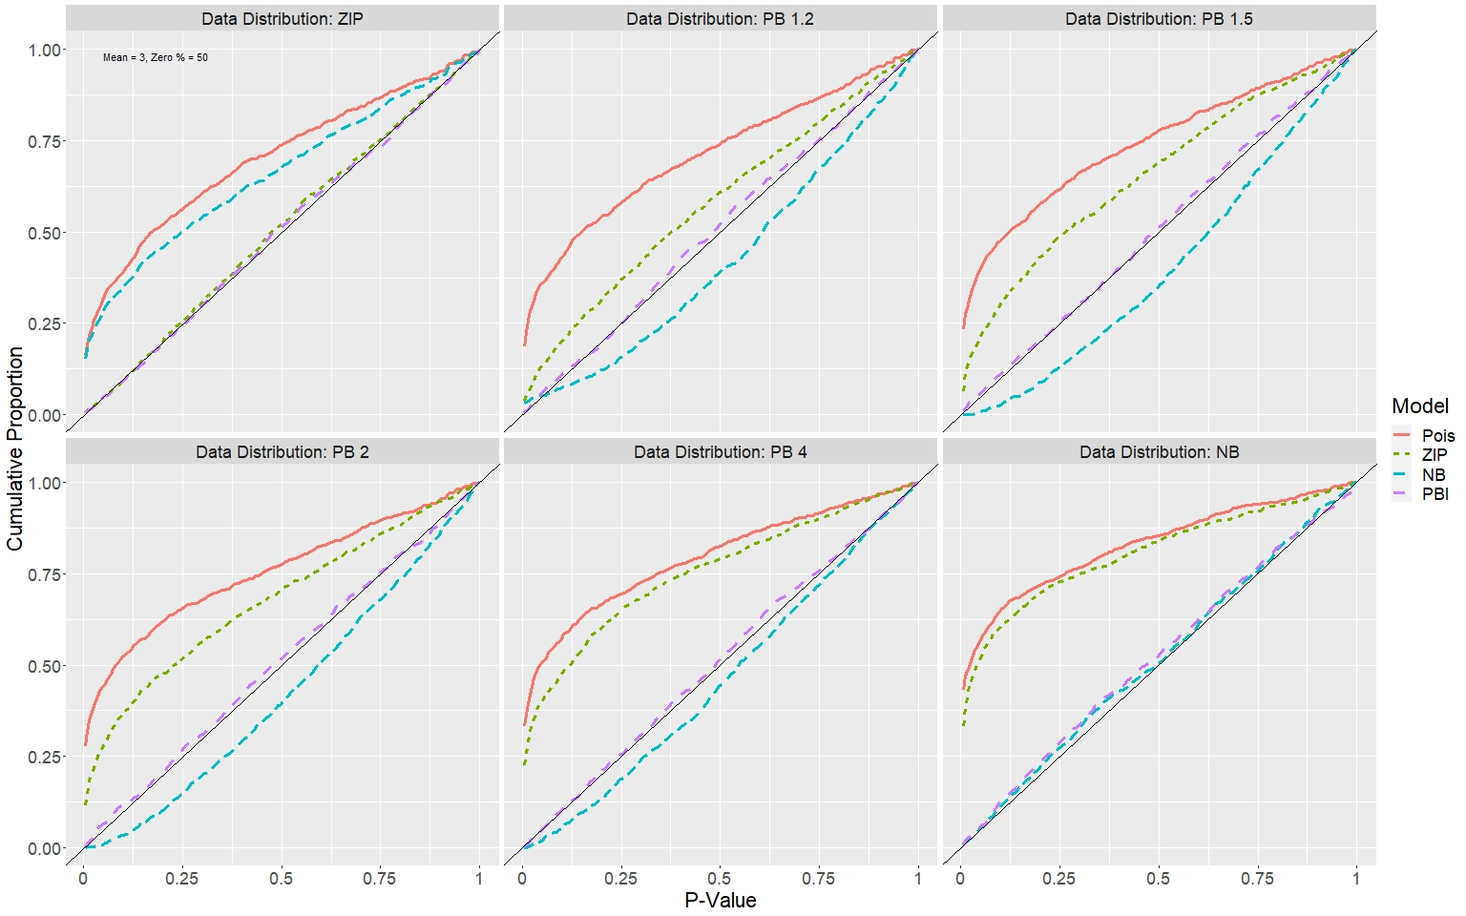
Type 1 Error Control
Sample size = 250/arm
Zero-inflation = 50%
Notes:
The ZIP and the NB are at opposite ends of a continuum of PB distributions.
PB x represents the PB distribution with scale factor multiplied by x relative to what it is in the pure ZIP case.
PB ∞ is an NB distribution.

Slide 10
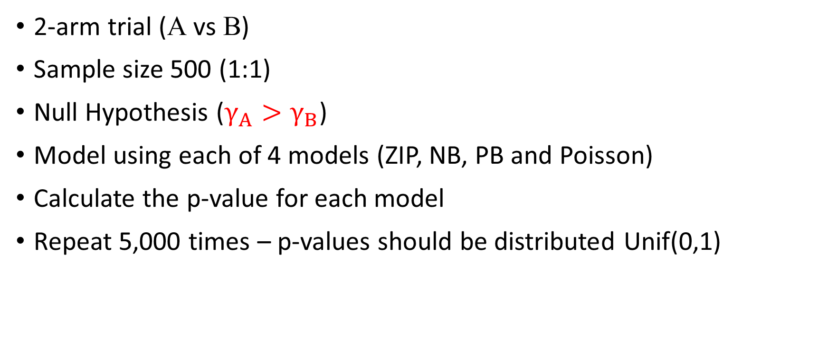
Testing scenarios – synthetic data
2-arm trial (A vs B)
Sample size 500 (1:1)
Null Hypothesis ($γ_{A}>γ_{B}$)
Model using each of 4 models (ZIP, NB, PB and Poisson)
Calculate the p-value for each model
Repeat 5,000 times – p-values should be distributed Unif(0,1)

Slide 11
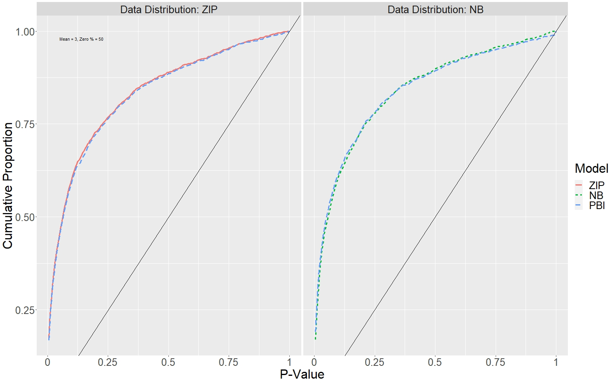
Power
Notes:
Modelling a treatment effect.

Slide 12
Possible Next Steps
Report Findings (Publish / Present)
Real-world data
R-package?

Slide 13
Contact Details
E-mail: Alan.Herschtal@monash.edu

Slide 14
Questions & Suggestions
?
Alan.Herschtal@monash.edu

Slide 15
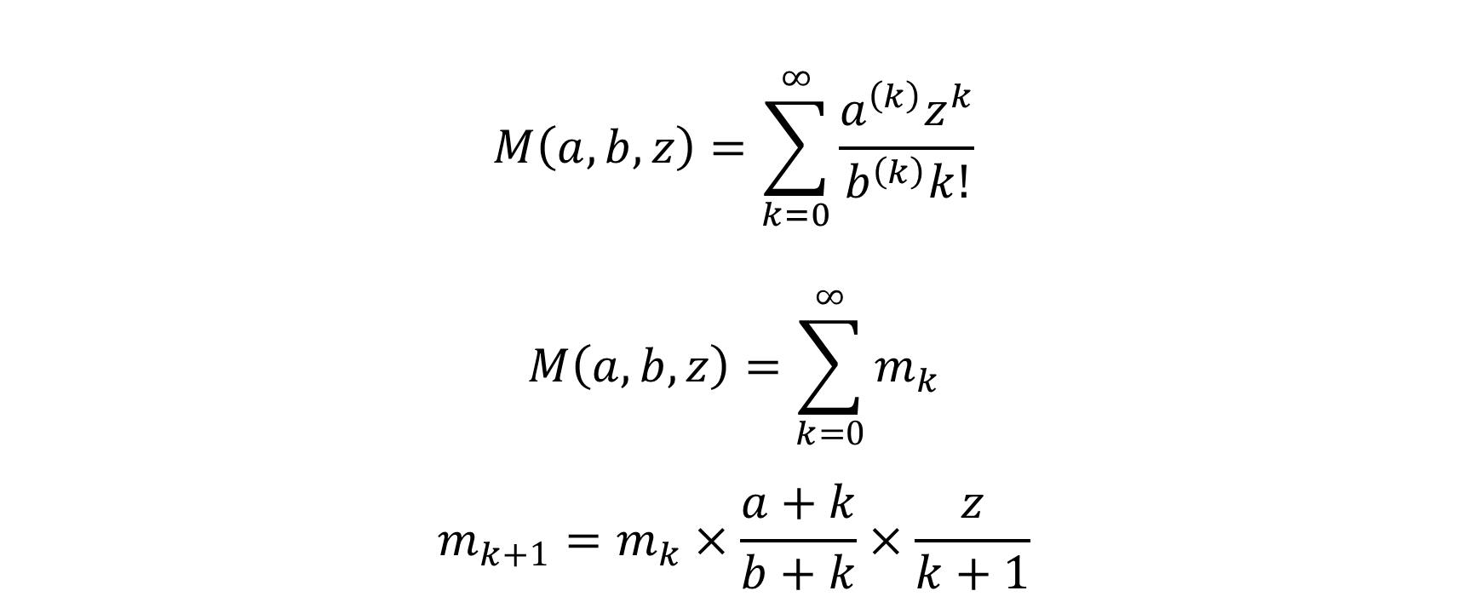
Computation via Recurrence Relation
$$M\left(a,b,z\right)=\sum_{k=0}^{∞}{\frac{a^{\left(k\right)}z^{k}}{b^{\left(k\right)}k!}}$$
$$M\left(a,b,z\right)=\sum_{k=0}^{∞}{m_{k}}$$
$$m_{k+1}=m_{k}×\frac{a+k}{b+k}×\frac{z}{k+1}$$

Slide 16
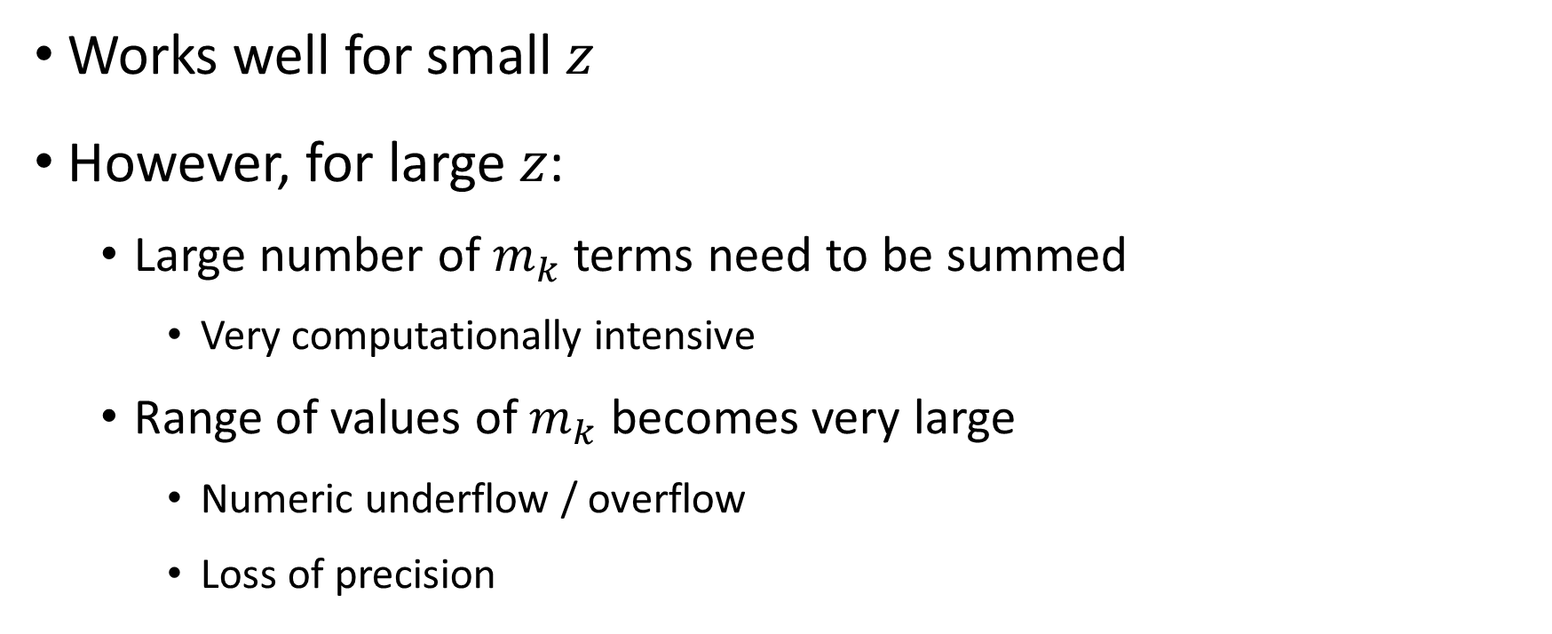
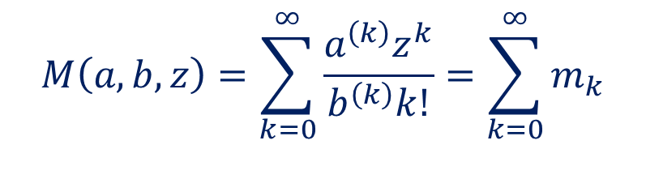
Computation via Recurrence Relation
Works well for small $z$
However, for large $z$:
Large number of $m_{k}$ terms need to be summed
Very computationally intensive
Range of values of $m_{k}$ becomes very large
Numeric underflow / overflow
Loss of precision
$$M\left(a,b,z\right)=\sum_{k=0}^{∞}{\frac{a^{\left(k\right)}z^{k}}{b^{\left(k\right)}k!}}=\sum_{k=0}^{∞}{m_{k}}$$
Notes:
The large z portion of the parameter space is important because the negative binomial distribution corresponds to the PSB with z → $∞$.

Slide 17
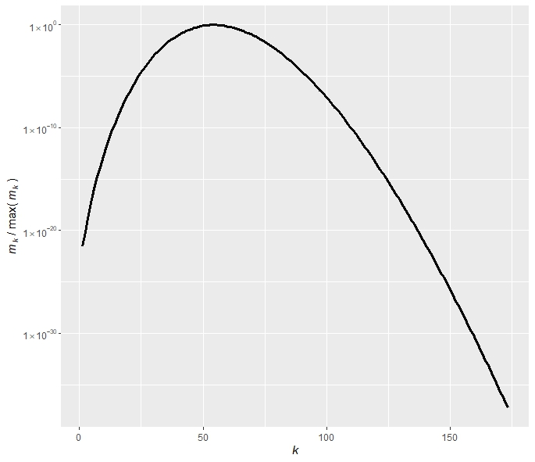
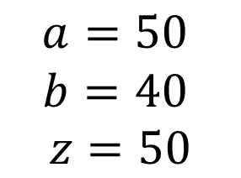
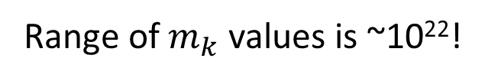
Computation via Recurrence Relation
$$a=50$$
$$b=40$$
$$z=50$$
Range of $m_{k}$ values is ~10²²!

Slide 18
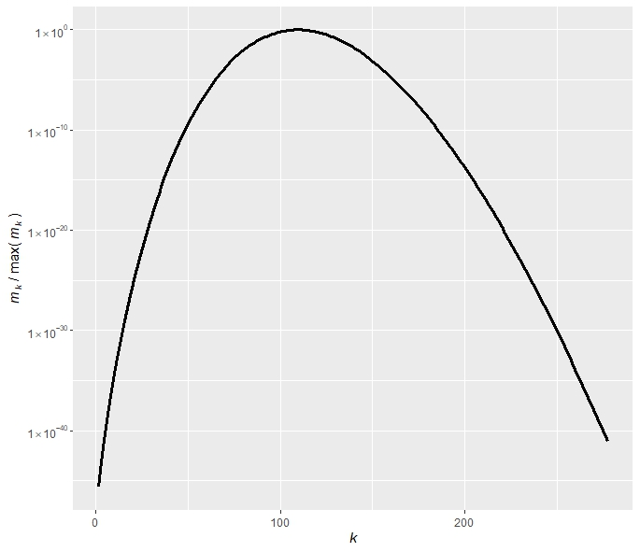
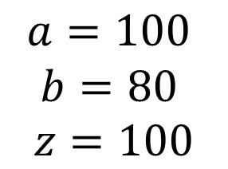

Computation via Recurrence Relation
$$a=100$$
$$b=80$$
$$z=100$$
Range of $m_{k}$ values is ~10⁴⁵!

Slide 19
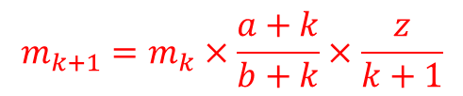
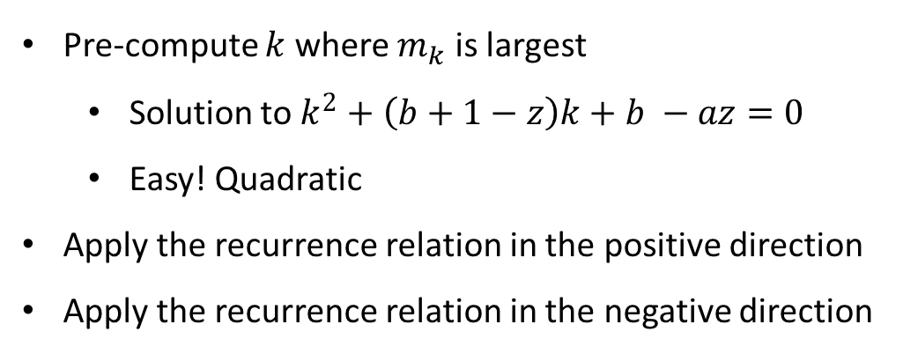
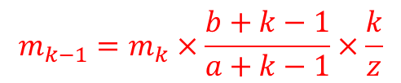
Computation via Recurrence Relation
$$m_{k−1}=m_{k}×\frac{b+k−1}{a+k−1}×\frac{k}{z}$$
$$m_{k+1}=m_{k}×\frac{a+k}{b+k}×\frac{z}{k+1}$$
Pre-compute $k$ where $m_{k}$ is largest
Solution to $k^{2}+\left(b+1−z\right)k+b −az=0$
Easy! Quadratic
Apply the recurrence relation in the positive direction
Apply the recurrence relation in the negative direction

Slide 20
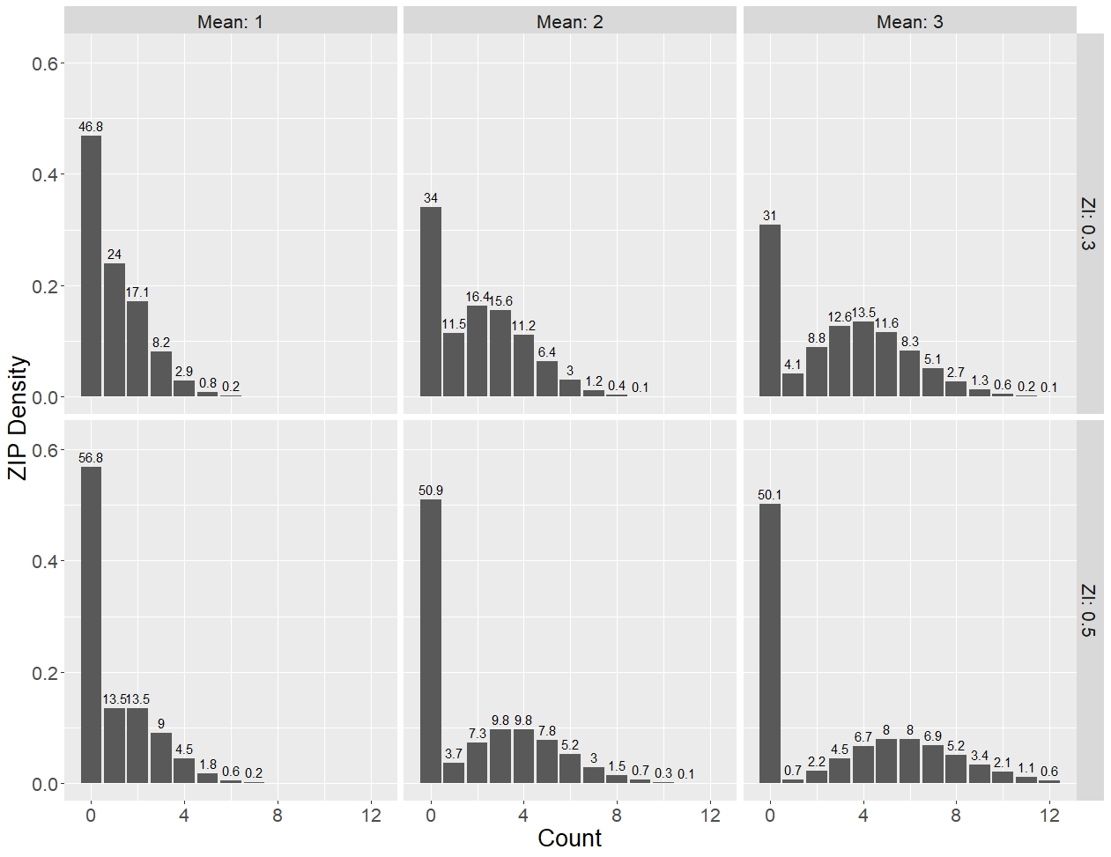
ZIP Densities

Slide 21
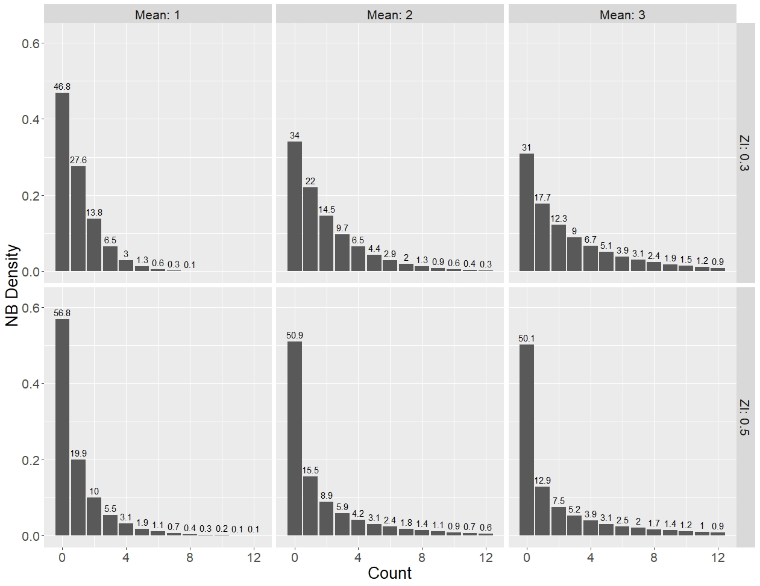
NB Densities

Slide 22
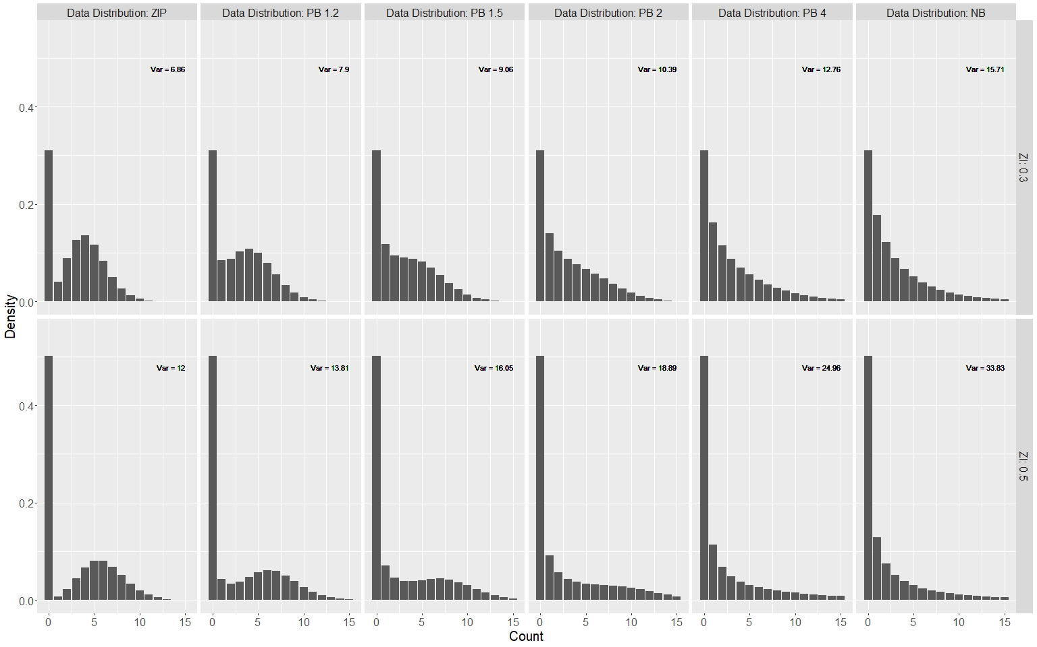
PB Densities

Slide 23
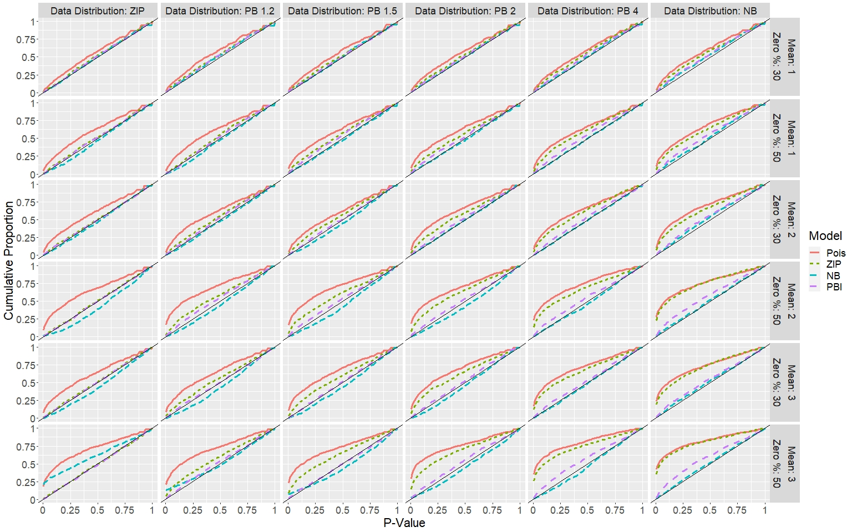
Type 1 Error Control

